Slide 1
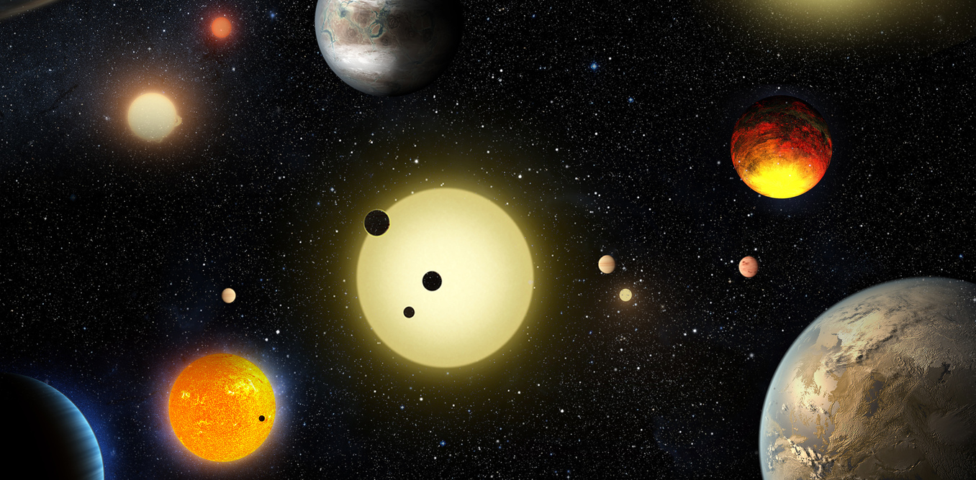
EXOPLANETS
Exoplanets
Talk prepared by:
Santanu Mohapatra(14PH20032)
Department of Physics, IIT Kharagpur.

Slide 2
We all know that there are innumerable stars exist like our Sun. So, planets
Revolve around these stars in a manner similar to the way the seven planets
Revolve around our Sun.
These planets outside our solar system are known as exoplanets.
Several thousand known exoplanets have now been discovered.

Slide 3
How can we discover planets?
Try to image them
2. Observe the motion of the star as it gets pulled by the
planet
3. Look at stars and wait for planets to go in front of them,
making the stars temporarily dimmer

Slide 4
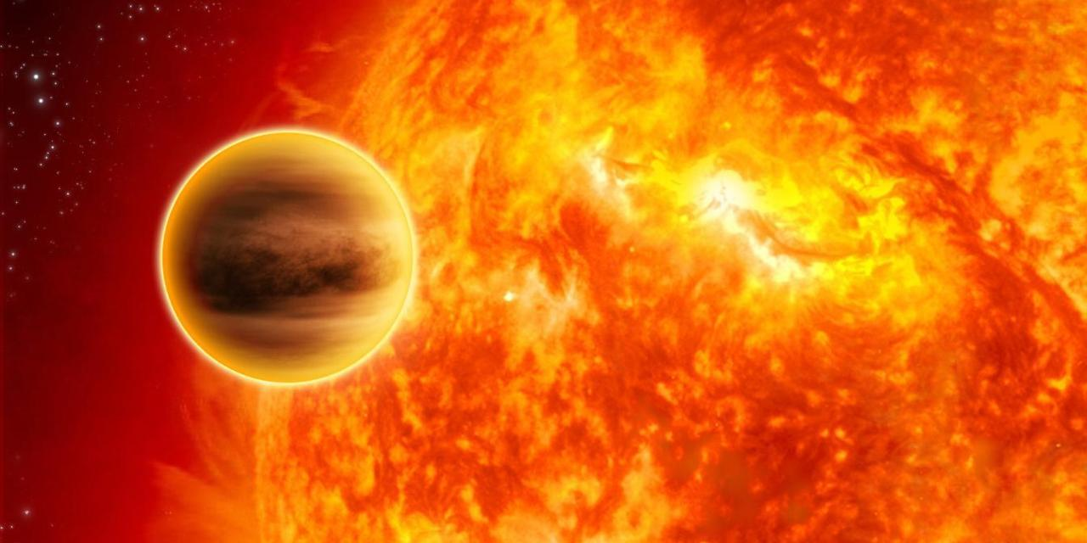
Problems in finding the Exoplanets
1.Planets reflect very small amount of light as compared to its corresponding star.
2.Its very small size as compared to the star.
3. Star’s glare.(almost dims out planet’s light)
51 Pegasi b was the first confirmed exoplanet (Credit: Nasa/JPL-Caltech)
Orbital period=4.230785 ± 0.000036 d

Slide 5
METHODS AND PRINCIPLES
Gravitational Tug of War causes star to “wobble”
Radial Velocity: Motion toward and away detected by Doppler shifts in stellar spectra
Astrometry: Motion Side to Side (in plane of sky) detected in images of stars compared to background
RADIAL VELOCITY
ASTROMETRY
TRANSIT
MICROLENSING
IMAGING
Eclipses by planets dim the star’s light (very slightly)
Detected by temporary brightness decrease in light curve
Stars sometimes gravitationally lens background stars and the planet can contribute (very slightly)
Detection of planet is small blip in lens light curve
Planets reflect the starlight and this can be imaged
Very Difficult: Requires nulling the star- two ways

Slide 6
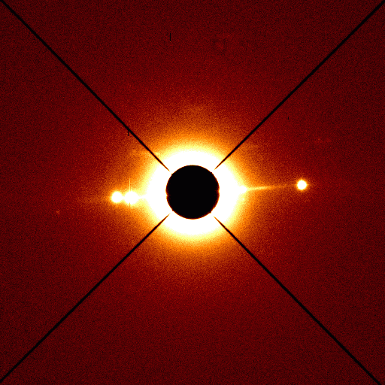
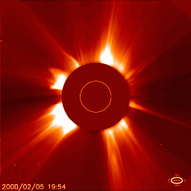
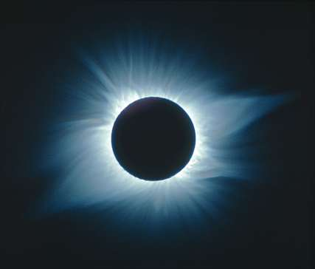
Examples of coronagraph technique for planet
A coronagraph is a telescope that can see things very close to the Sun. It uses a disk to block the Sun's bright surface, revealing the faint solar corona, stars, planets and sun grazing comets. In other words, a coronagraph produces an artificial solar eclipse.
Telescope image of
Saturn, rings and
moons with a
coronagraph
SOHO spacecraft
image of the sun
with a coronagraph
?
Notes:
Are these real?
Why can’t we see planets?

Slide 7
Techniques for finding extrasolar planets
Stellar “Wobble” Method
Is the sun influenced by the gravitational force
of the planets?
Jupiter orbit around the center of the sun.

Slide 8
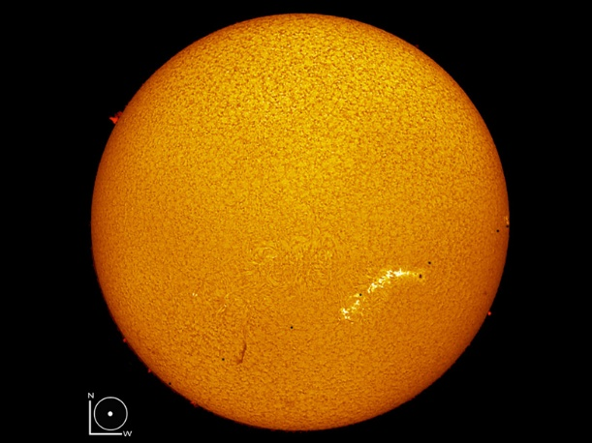
Suppose Jupiter and the Sun could be placed on a see-saw. Which point is closest to the center of balance?
Size of sun, Jupiter roughly to scale.
Sizes and distances not to scale with each other.
A
B
C
D

Slide 9
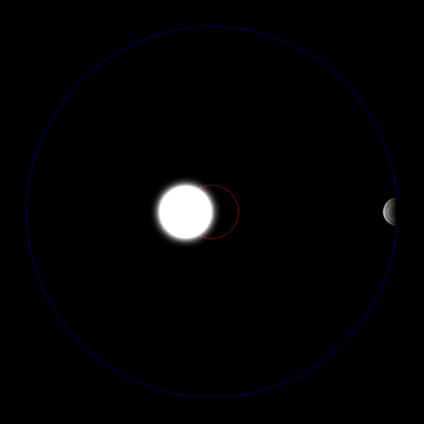
Wobbles of the star due to planet’s gravitational
Force.
Note that the star is much brighter than the planet, so we observe the motion of the star produced by the planet. This is called an “indirect detection technique”.

Slide 10
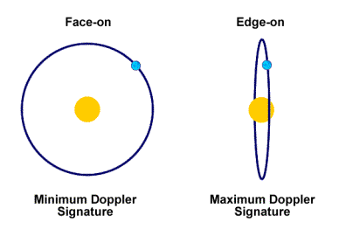
We don’t know the inclination of the planet’s orbit
Notes:
Draw on the board here: planet moves, but does sun also move? Yes.
And explain the Doppler shift.

Slide 11
The Doppler technique only provides the minimum mass of the planet if the orientation is not known (which is most of the time).
Notes:
Are these real?
Why can’t we see planets?

Slide 12
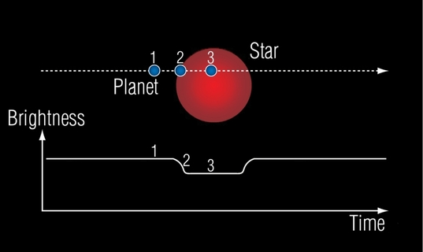
TRANSIT METHOD
(Brightness Variations Due to Planet Eclipses)
NASA, ESA, G. Bacon (STSci)

Slide 13
What would you learn about a planet if you found it with the planetary transit technique?
(A) Its radius
(B) Its mass
(C) Its orbital period
(D) Both its radius and its orbital period
Notes:
Draw on the board here: planet moves, but does sun also move? Yes.
And explain the Doppler shift.

Slide 14
A special geometry is needed for a transit

Slide 15
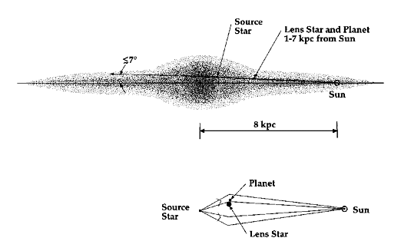
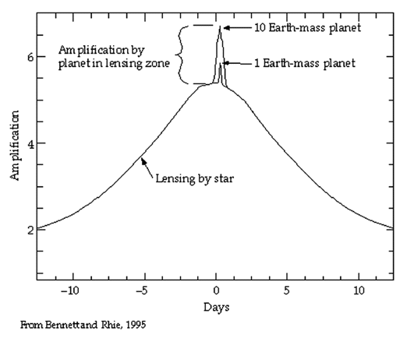
MICROLENSING METHOD
(Quick Brightness Spikes Due to Gravitational Lensing of Background Stars)

Slide 16
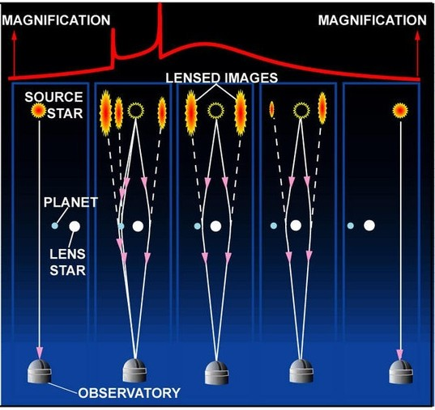
PLANET DETECTION THROUGH MICROLENSING
The microlensing process in stages, from right to left. The lensing star (white) moves in front of the source star (yellow) magnifying its image and creating a microlensing event. In the fourth image from the right the planet adds its own microlensing effect, creating the two characteristic spikes in the light curve.
OGLE

Slide 17
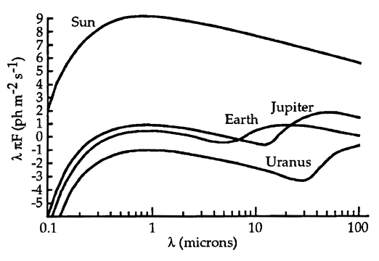
IMAGING METHOD
(Imaging of Reflected/Reprocessed Starlight)
Optical: star/planet = 1 billion = 10⁹
Infrared: star/planet = 1 million = 10⁶
We need to search in the infrared and we need some extra help! Block out the star!

Slide 18
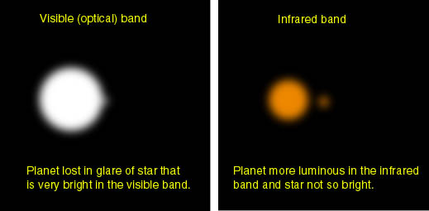
IMAGING METHOD
(Imaging of Reflected/Reprocessed Starlight)

Slide 19
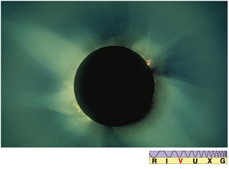
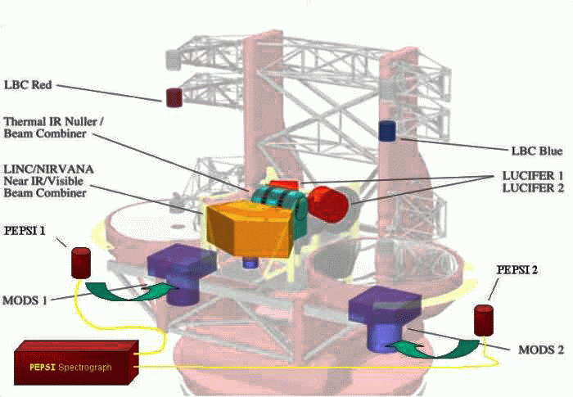
IMAGING METHOD
Interferometry and Adaptive Optics (AO)
nulling the star light
This old fashioned way of blocking out the star is called a coronagraph, which is being replaced by interferometry ….
Requires large telescopes and specialized instrumentations…

Slide 20
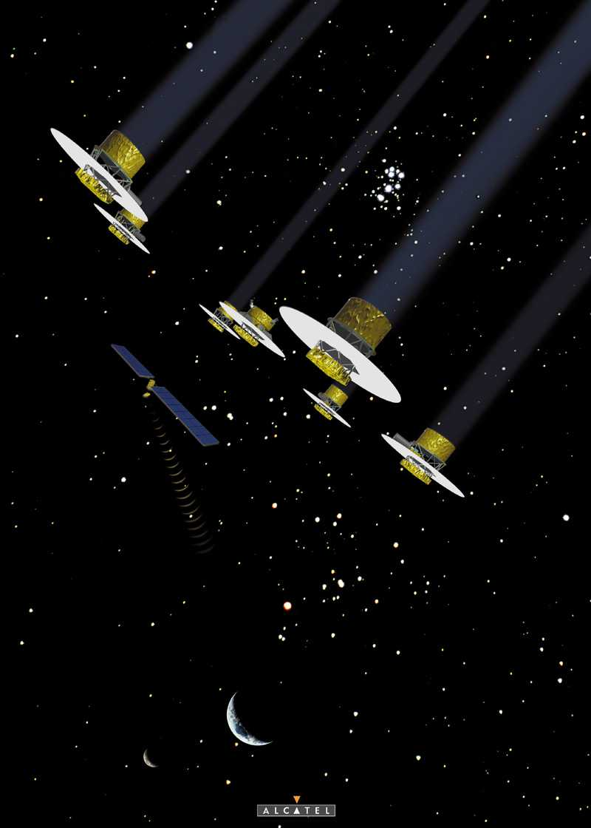
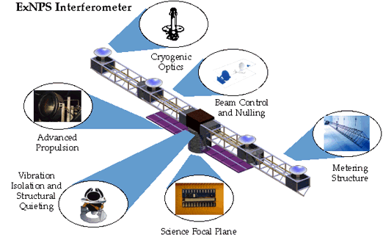
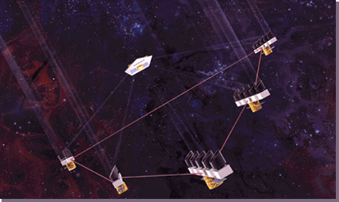
IMAGING METHOD
(taking it to the next level)

Slide 21
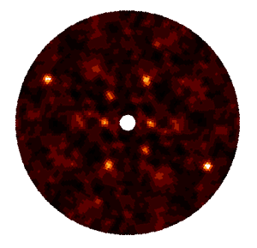
IMAGING METHOD
(Venus, Earth, Mars, and Jupiter)
Earth
Venus
The images are reflected about the origin- artifact of interferometry method
Jupiter
Mars
Space based interferometry can probe deeper… mostly because of the bigger collecting area of the telescope.

Slide 22
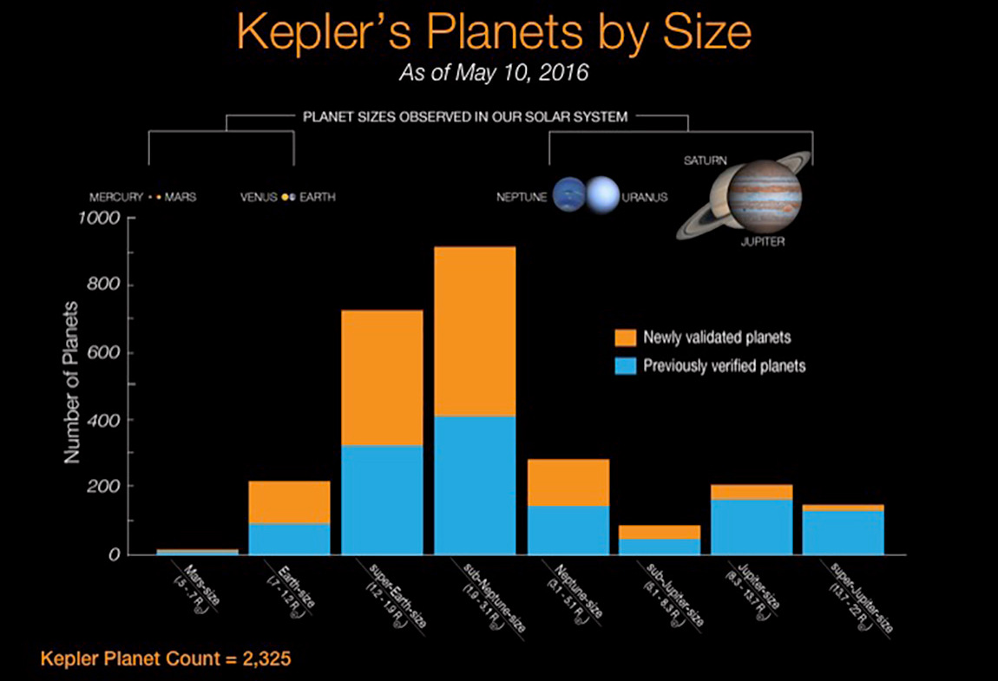
Credit : NASA

Slide 23
In search for life
Out of these exo-planets, some of them can be like earth and support life as well,
If a planet comes under a zone where water can be found in liquid form, its called a
Habitable or Goldilocks zone of that star.
The size and composition of a planet also matters in order to sustain life.
Some examples of earth-like planets/super earths found recently are:
Kepler-186f, Kepler-62f, Kepler-452b

Slide 24
Thank You

